Slide 1
Online Notes
The Online Notes project is a web-based application developed using Java, MySQL, JDBC, Servlet, JSP, HTML, and CSS. It allows users to manage their notes efficiently. The project includes:
Login and Signup Page: Secure user authentication system for new and returning users.
Home Page: A dashboard where users can add new notes with titles and descriptions.
Show Notes Page: Displays all the saved notes, with options to update or delete them. Users can view the content and make necessary changes to their notes.
The application uses MySQL as the database for storing user and note data, while JDBC connects the front-end to the back-end logic. The project is structured with a clean user interface, incorporating HTML and CSS for seamless navigation and interaction.

Slide 2
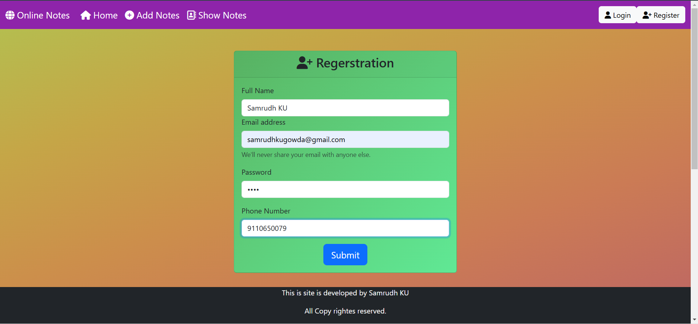
Regerstration Page: Hear we can resgister to the Web Application.

Slide 3
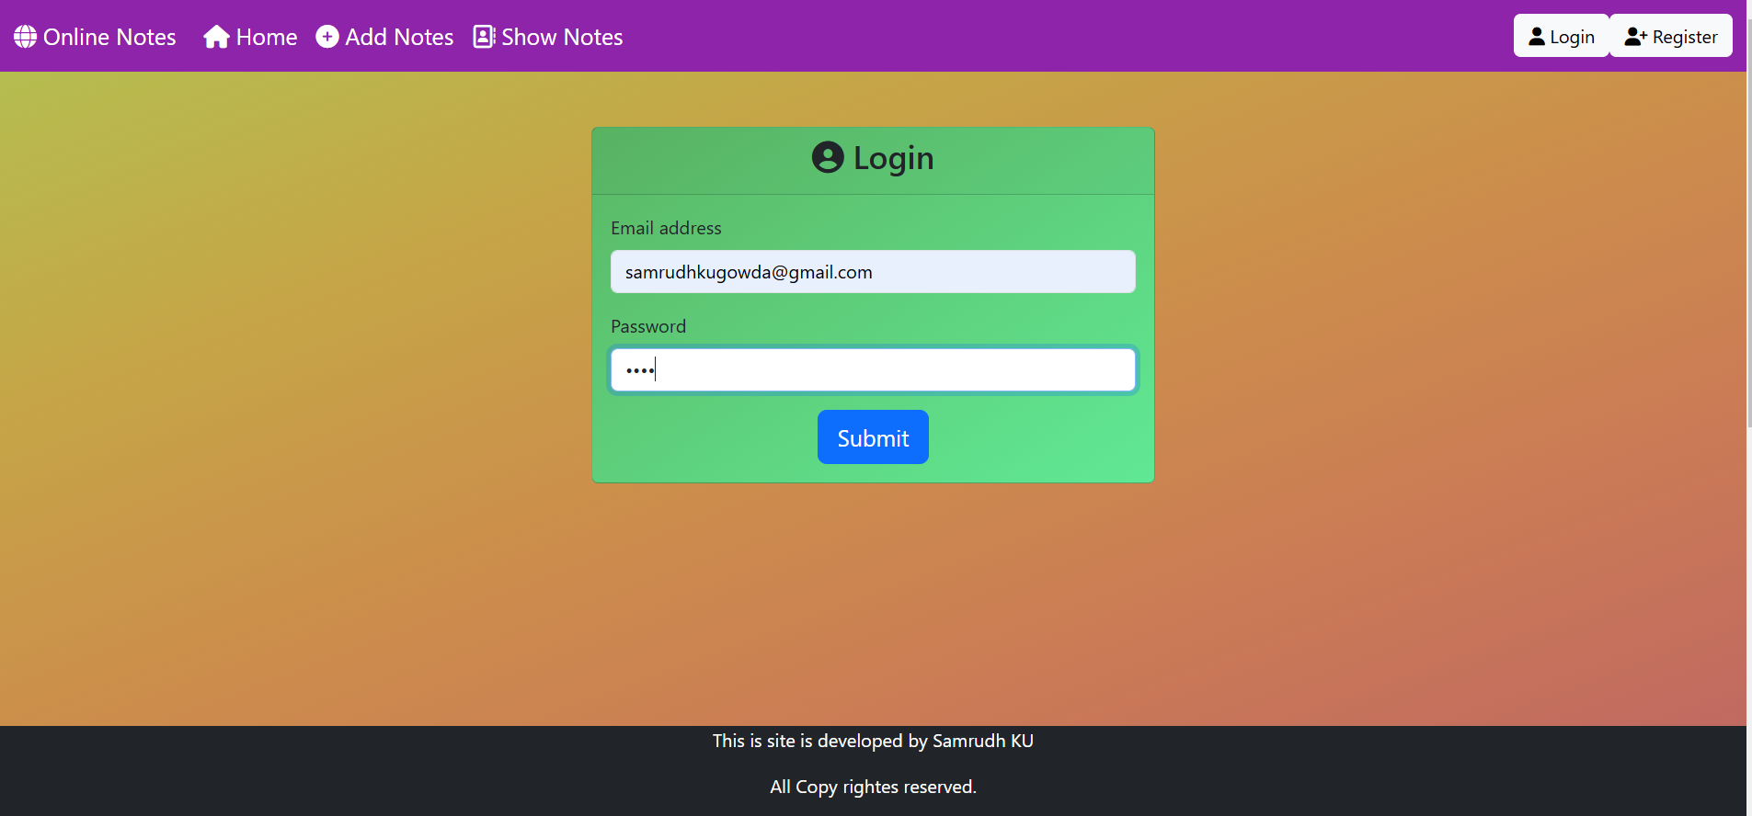
Login Page: Hear we can login to Web Application using Email address and password.

Slide 4
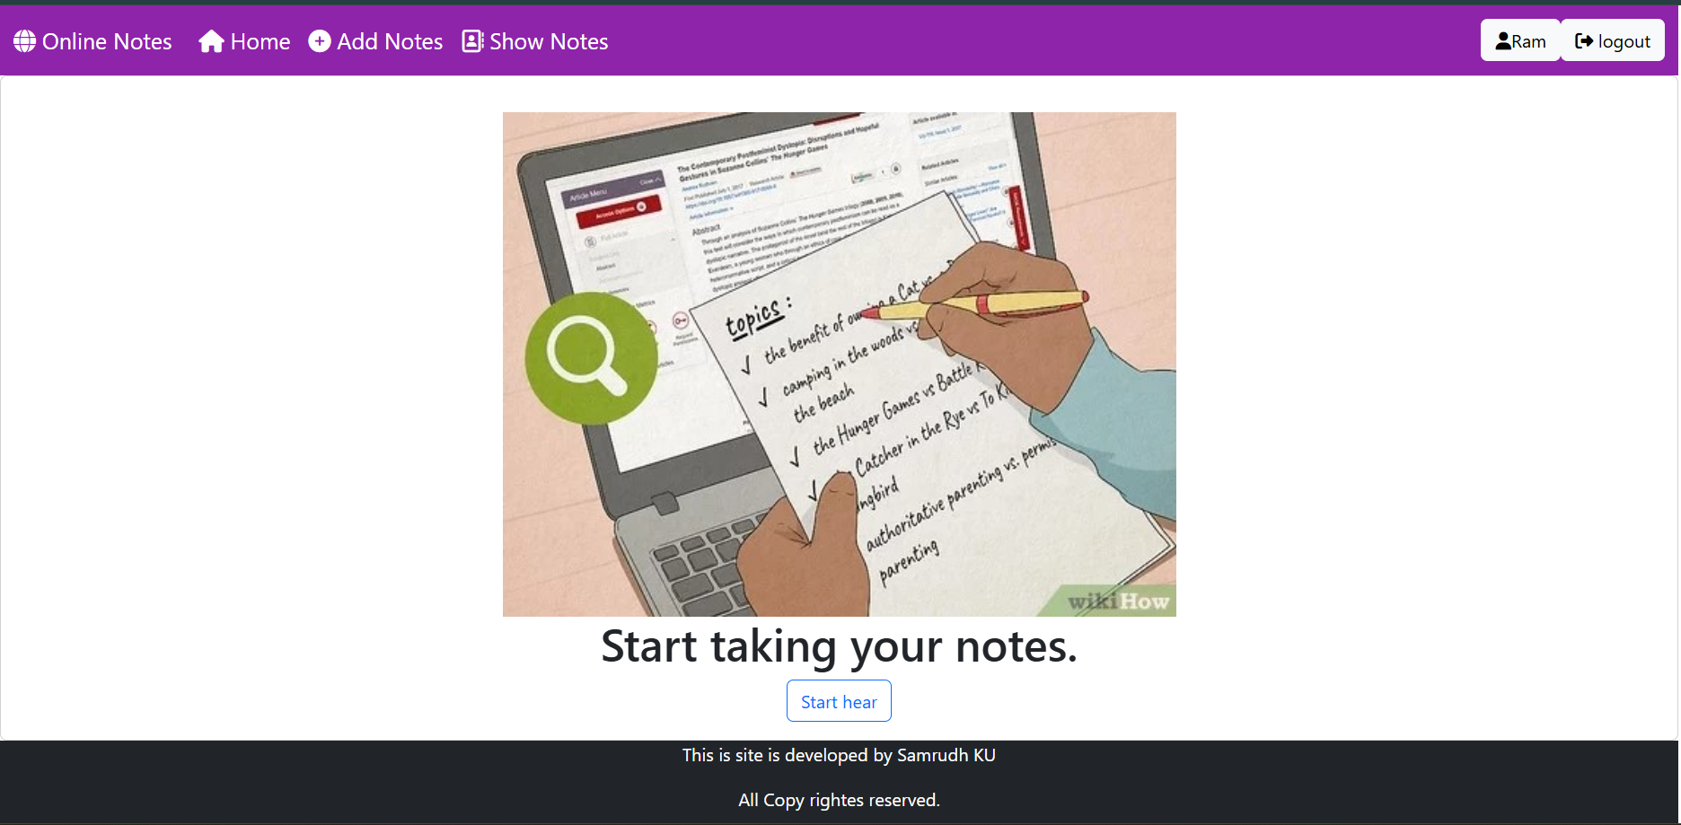
Home Page: Hear we can access the functionality of the Web Applications.

Slide 5
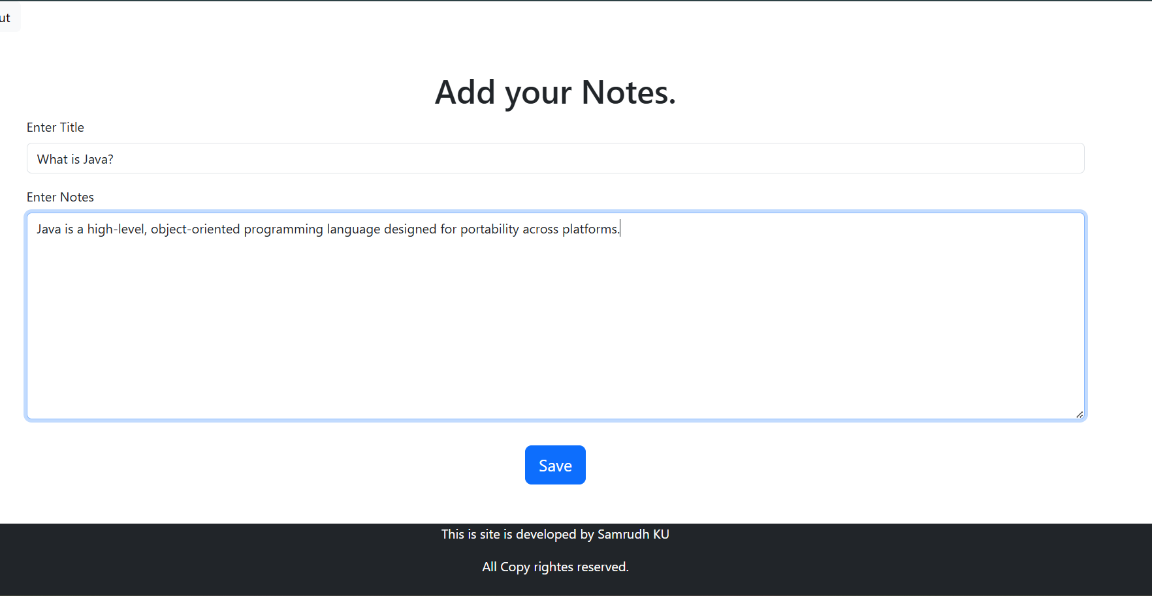
Add Notes Page: We can add our important notes hear.

Slide 6
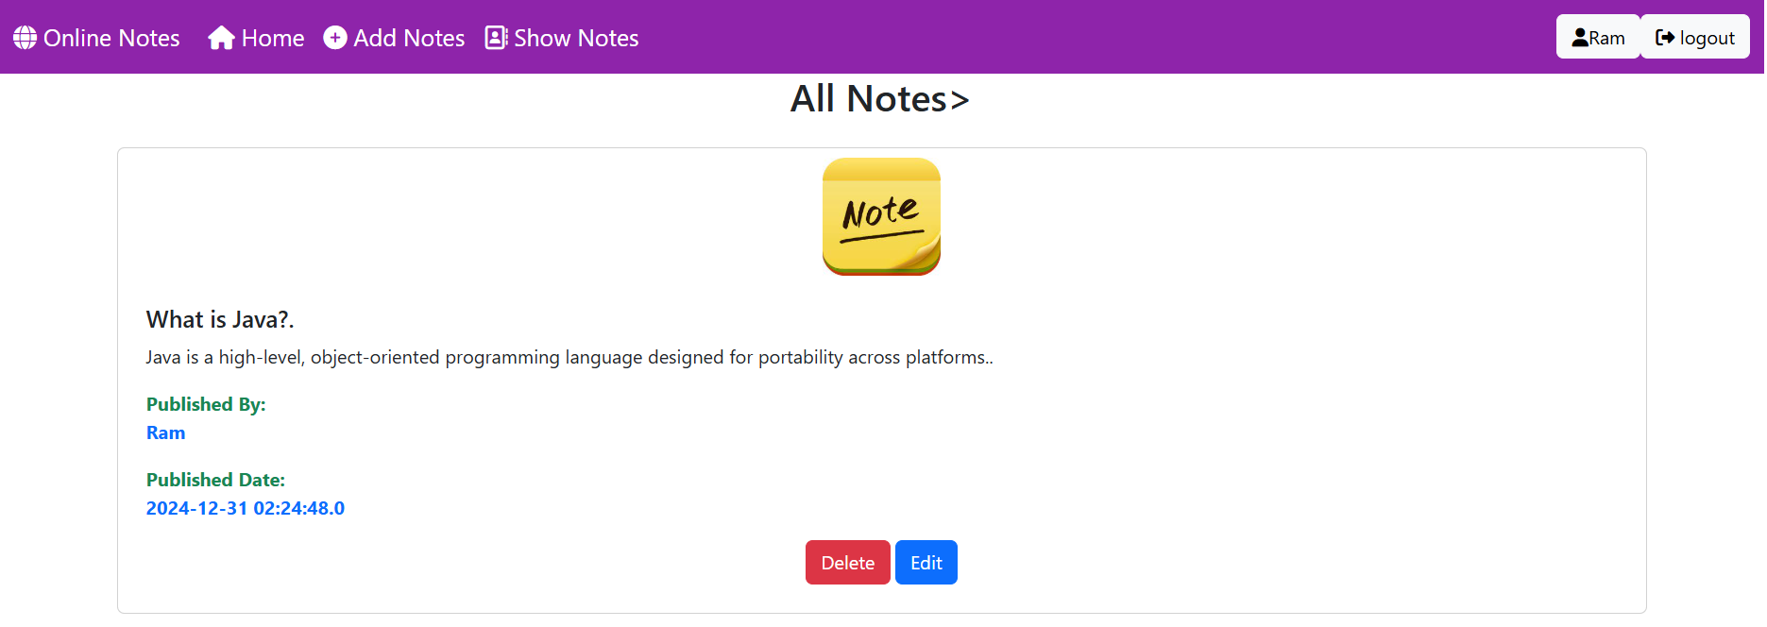
Show Notes Page: We can view all the added important notes and manage them by updating or deleting them.

